Slide 1
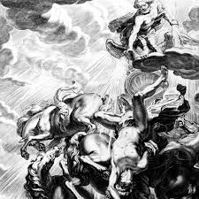

Framing Responses to AI Societal Security Risks: Do We Have a Template?
AI forum Hungary 2025
4th December,2025

Slide 2

Some topics for general consideration
1. What is societal security?
2. Why societal security might be a target?
3. What is the cheapest and most reliable way to undermine societal security?
4. How to prevent the destabilization of the societal security?

Slide 3
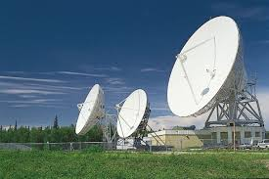

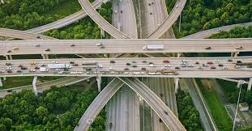
1. What is societal security?
Ability to protect society’s core functions, fundamental values, and
identity from threats that could disrupt its way of life;
Societal security is inalienable from the governability i. e. national security and the foreseeable perspectives of harmonic development.
Crisis management: The ability to prevent, prepare for, respond to, and recover from crises, whether sudden or creeping, that threaten the population.

Slide 4

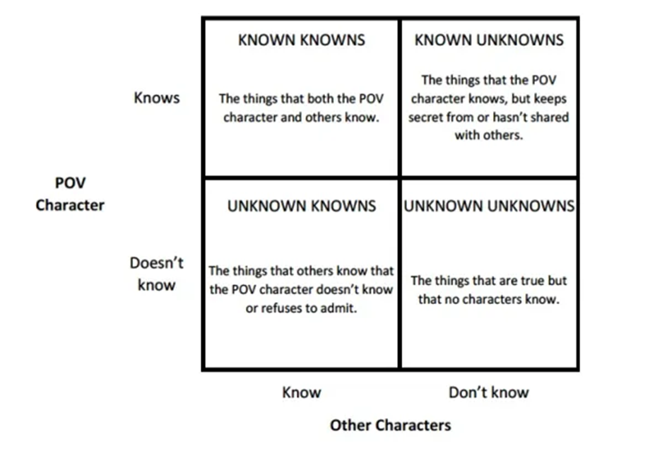
2. a. Why societal security might be a target?
Network of adverse interests: from challenges to conflicts through frictions all impacting gobernability;
Shift of focuses from perspectives to crisis management: escalation;

Slide 5
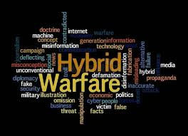
2. b. Why societal security might be a target?
For the societal security the maximum risks are the unknown unknowns since we are not prepared to take any decision to reduce or transfer or manage this kind of risk.
That is exactly, what the use of AI in the cognitive sphere for purposes of the hybrid warfare means!

Slide 6

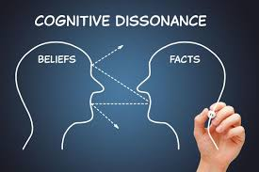
3. a. What is the cheapest and most reliable way to undermine societal security?
„To subjugate humanity, it is not the army, spy agencies, or police that are needed, but the media and authority.” Duncan Shelley: Mind Killers
Provoking cognitive dissonance, i. e. “an uncomfortable feeling that comes from believing or thinking two different things that cannot both be right.” The fragmentation of the society is achieved, disbelief planted, spontaneous, focal resistance is highly probable, the governability is undermined!
Consequences: the inefficiency of actions to be taken to prevent a multilevel political, economic, societal, social crisis. If such a crisis hits a defenseless society exposing it to a well-orchestrated hostile influence, the integrity, the independence, the freedom and all classic democratic values will be at stake.

Slide 7

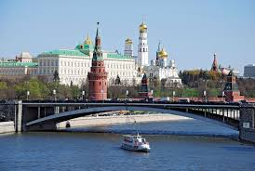

3. b. What is the cheapest and most reliable way to undermine societal security?
Sources of risk using AI: AI-generated or distributed fake communications to provoke cognitive dissonance through media agencies, platforms, institutions, social network groups, individuals, directly or indirectly. This kind of information may be distributed electronically or in even printed versions by state or non-state actors, private research groups, etc. …
Their purpose: reconnaissance and intelligence, surveillance and control, including digitally detected or registered by other means reactions.
The effects of such activities may be to distract, deceive, engage, manipulate, intimidate the target group in the targeted country.

Slide 8



4. a. How to prevent the destabilization of the societal security?
It requires active counter-measures to preserve the integrity of the society and preserve the societal security through maintaining the credibility of reliable information:
Innovative information processing from any sources to detect components of hybrid warfare;
Redundant verification of information validity using algorithm management;
o Applicability of criteria as compatibility, coherence and convergence;
o Upgrade of communication nationwide;
o Analysis of possible tendencies in hybrid warfare and ranking them according to their probability;

Slide 9


4. b. How to prevent the destabilization of the societal security?
Analysis and Assessment:
Innovative information theory;
o Information value status;
o Impact of information value status;
o Consequences of the dynamic changes;
Role of the AI:
Information gathering and preliminary processing;
Algorithmization of information;
Splitting, combining and re-combining compatible information;
Dynamic analysis and assessment of the predictable consequences;
Running the whole system.

Slide 10
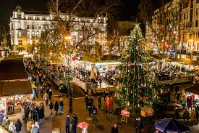
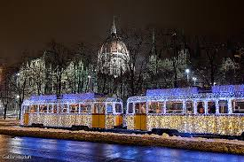
Thank you for your attention! Merry X-mas and Happy New Year!

