Slide 1






The Catholic University in the Service of the Future
Lóránd Ujházi
Professor Pázmány Péter Catholic University & Ludovika University of Public Service

Slide 2

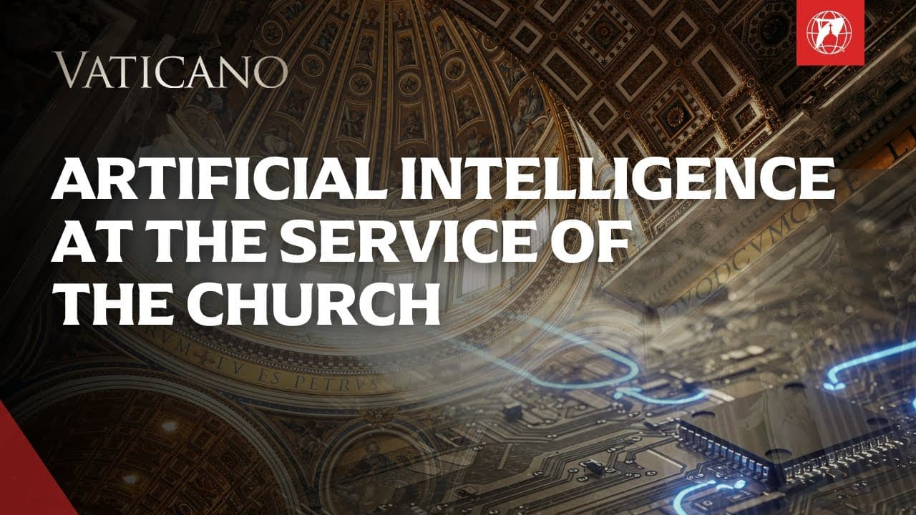
z

Slide 3
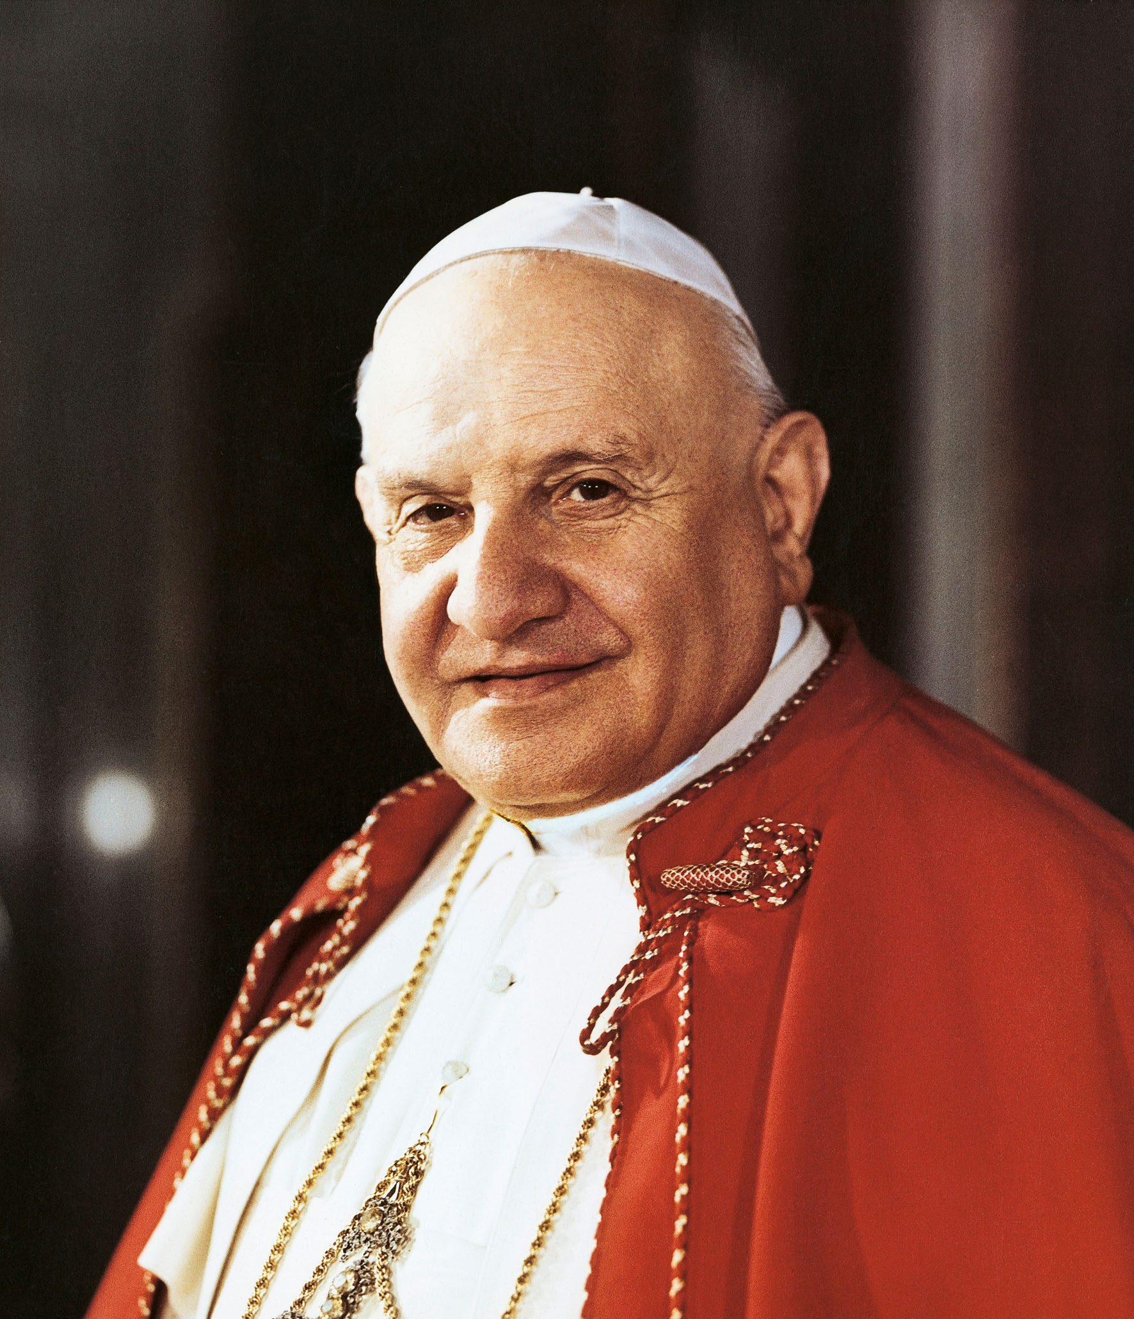
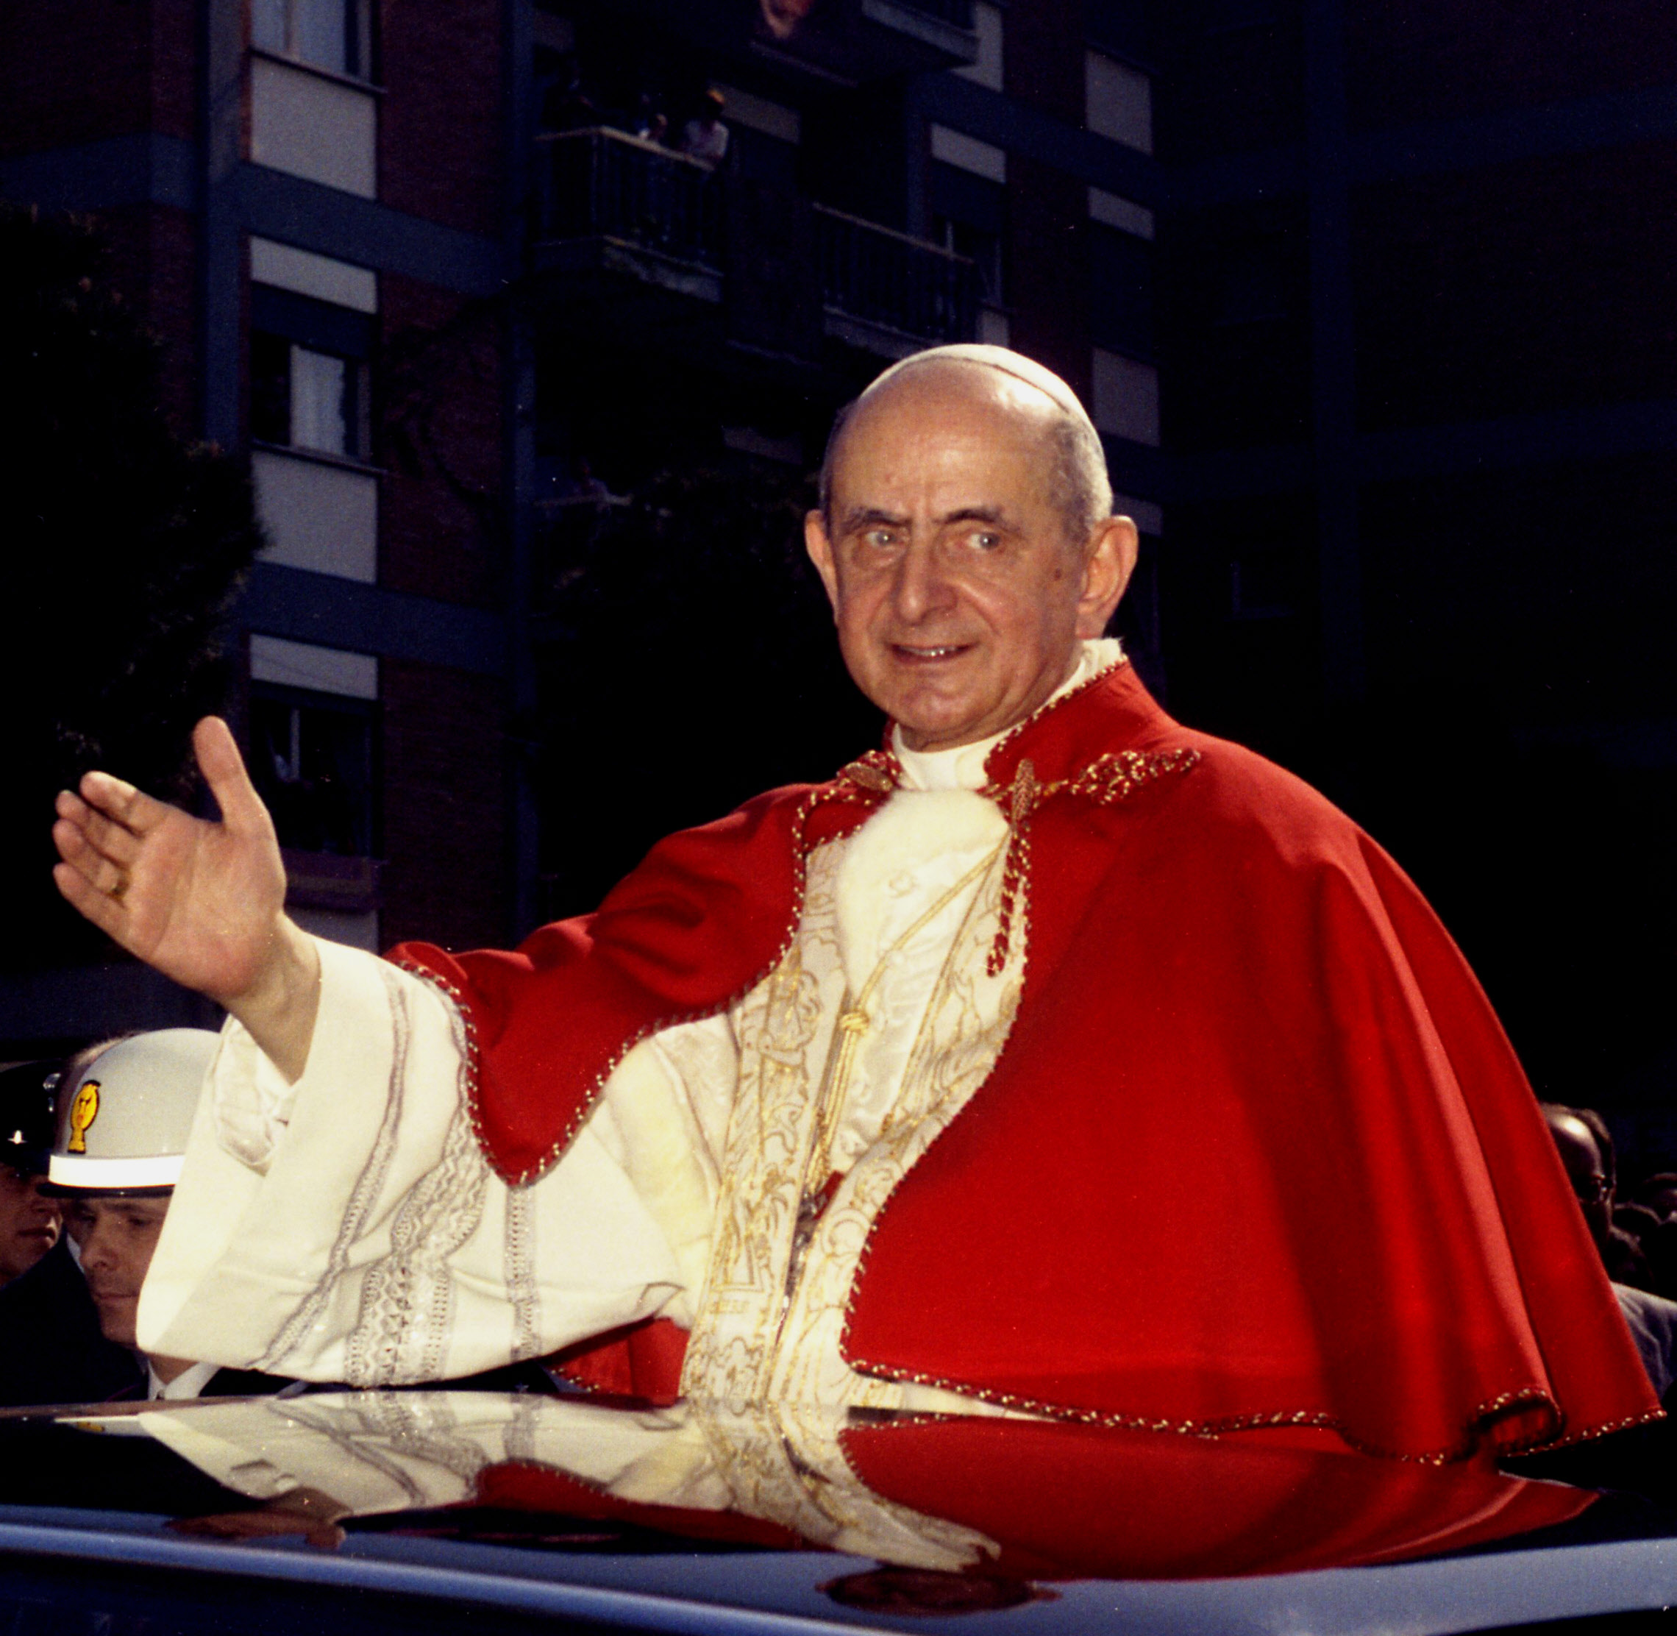
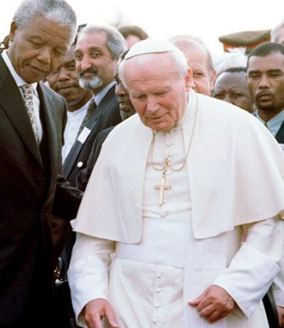
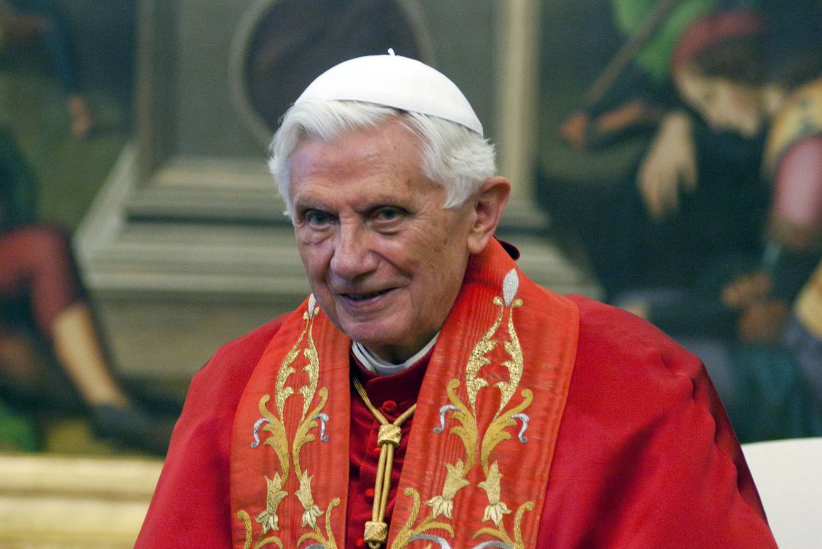
Personal Commitment to the Future of Humanity. (Peace)

Slide 4
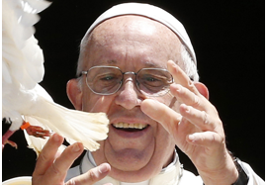
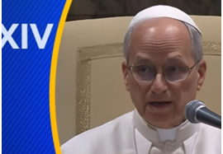
"Artificial intelligence is a galaxy of different realities... it is fascinating and terrible."
Promotion of 'Digital Peace'
(Pope Francis, G7 Summit, 2024).

Slide 5
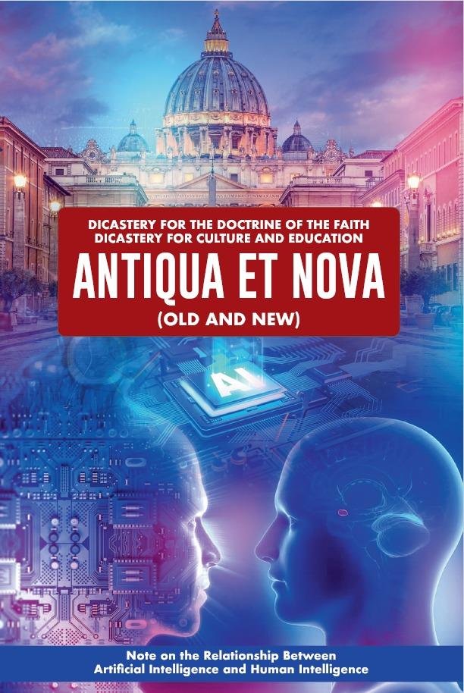

Roman Curia
Dicastery for Culture and Education
Pontifical Academy for Life
Episcopal conferences
Episcopal synods
Diocesian bishops
Universities.
The entire church was mobilized

Slide 6


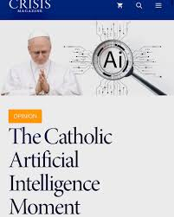
Popes - personal commitment - promotion of peace and social justice.
Complexity
Military
Conventional
Unconvantional
Non-militray
Complexity

Slide 7
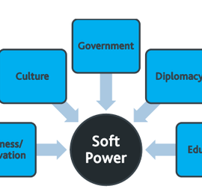
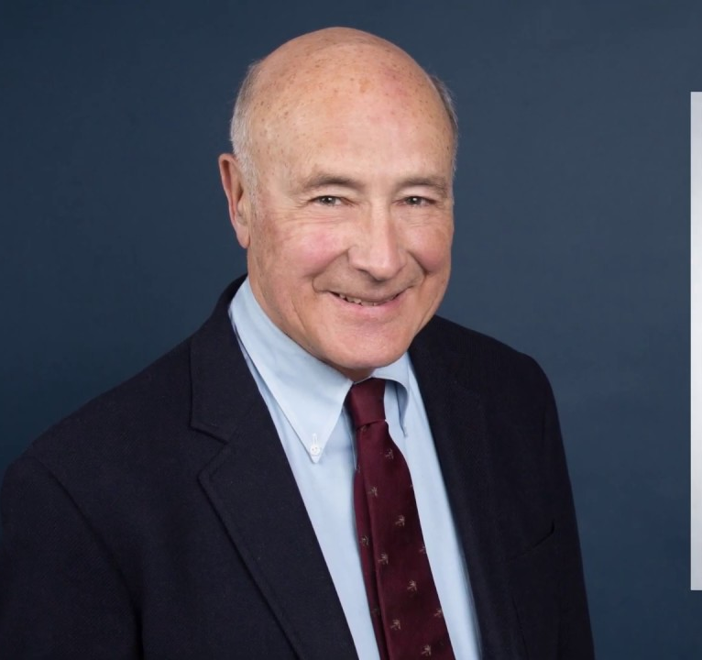

Research in complex way.
The Church's Role:
Moral soft power.
The Holy See does not have "technological hard power"
z

Slide 8
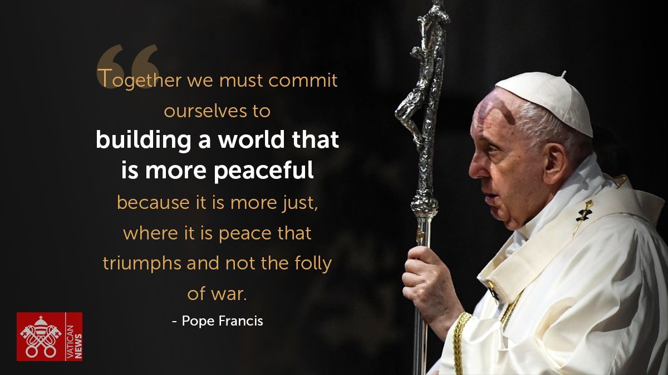
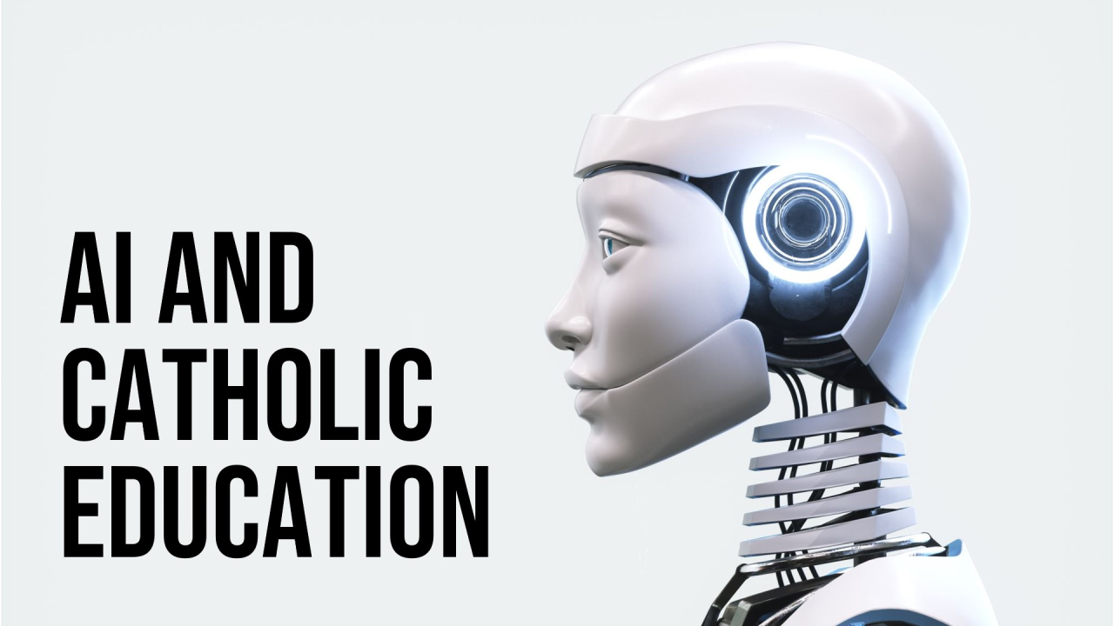
The University's Role: To translate the church’s message into the language of security policy. To provide the intellectual foundation for ethical AI To find a place of theology. Practical application
z

Slide 9

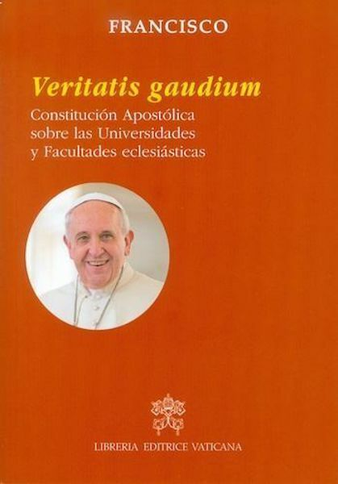
Legal framework.
Legal evolution
Methodology
Theology and other disciplines.

Slide 10
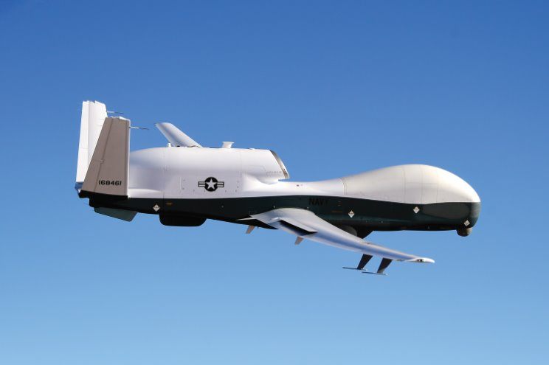

The Church has a long tradition of limiting technology when it threatens human dignity.
1139 (Second Lateran Council),
The Church banned crossbows (Against Christians)
It was considered too lethal
Disruptive to the social order.
Academy
(Similar to today's debate on Lethal Autonomous Weapons Systems (LAWS).

Slide 11

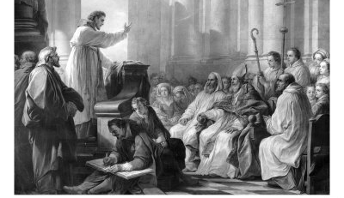
History
Augustine (De Civitate Dei) (Homilies)
Thomas Aquinas (Summa Theologiae) (university teacher)
Bonaventure (Collationes in Hexaëmeron)
Ivo of Chartres
"Theological-moral philosophical framework."
New technologies (war) linked to "academic" life.

Slide 12

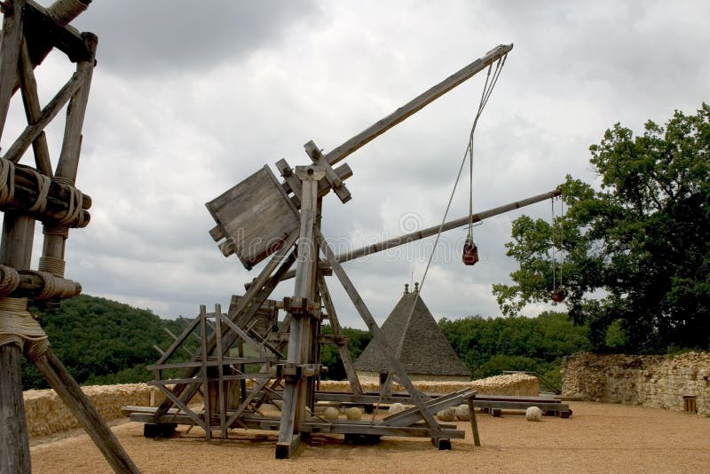
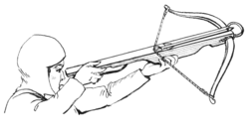
Legal institution based on biblical and theological foundations aimed at limiting warfare.
Certain weapons (Crossbow or projectile engine)
Penal canon law.
Military technology
Not only by moral theology.
Canonists: ​
Gratian ​
De Vittoria​

Slide 13
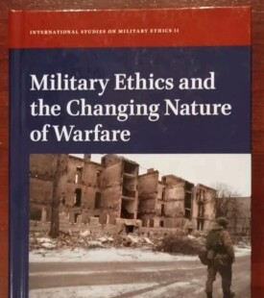
Code of Canon Law
Brief section on education
Defensive nature.
"Interdisciplinarity as an obstacle to be overcome rather than an opportunity"
Pius XI's 1931 Cons.AP. Deus Scientiarum Dominus. ​

Slide 14

First World War:
Greatest military-technological revolution.
Mechanization,
Air power,
Long-range weaponry,
Brutal, three-dimensional battlefield.
Total war,
Weapons of mass destruction,
The suffering of civilians,
and environmental damage.

Slide 15
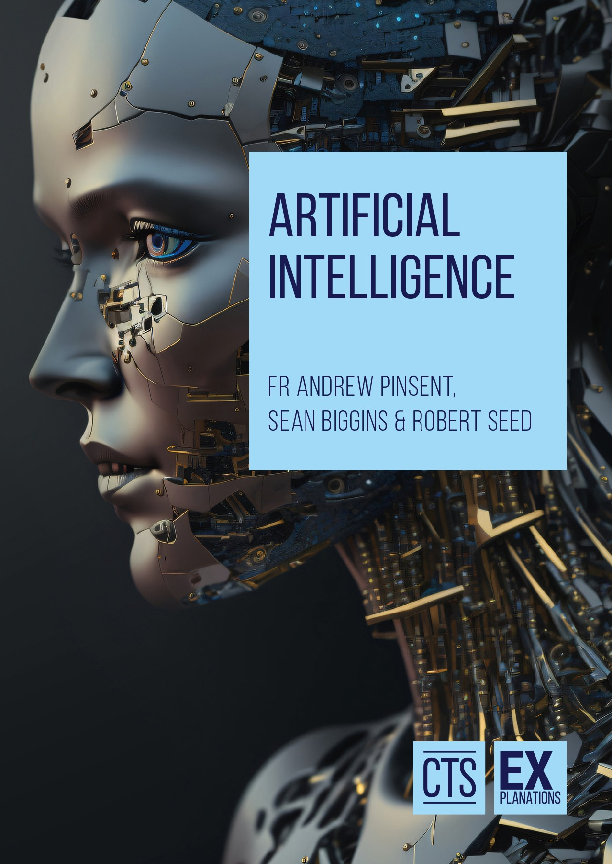
WWI (1st Shift): Industrialized warfare (Tanks, Gas)
Physical destruction.
AI Era
The "Cognitive-Industrial Revolution" (Pope Francis, G7 2024).
Not just physical harm, but the "Technocratic Paradigm".(Laudato Si').
z

Slide 16


Pius XII (1943)
Encyclical Divino afflante Spiritu 1943
(Archaeology, history, linguistics, and literary studies in examining the original scriptural texts.)
Most brutal period of the systematic extermination of the Jews.
Not only a diplomatic response .
A theological and scholarly one.
"Historical criticism does not weaken but rather reinforces the historical credibility of the Old Testament.'
Israel’s unique, God-given role in salvation history.

Slide 17
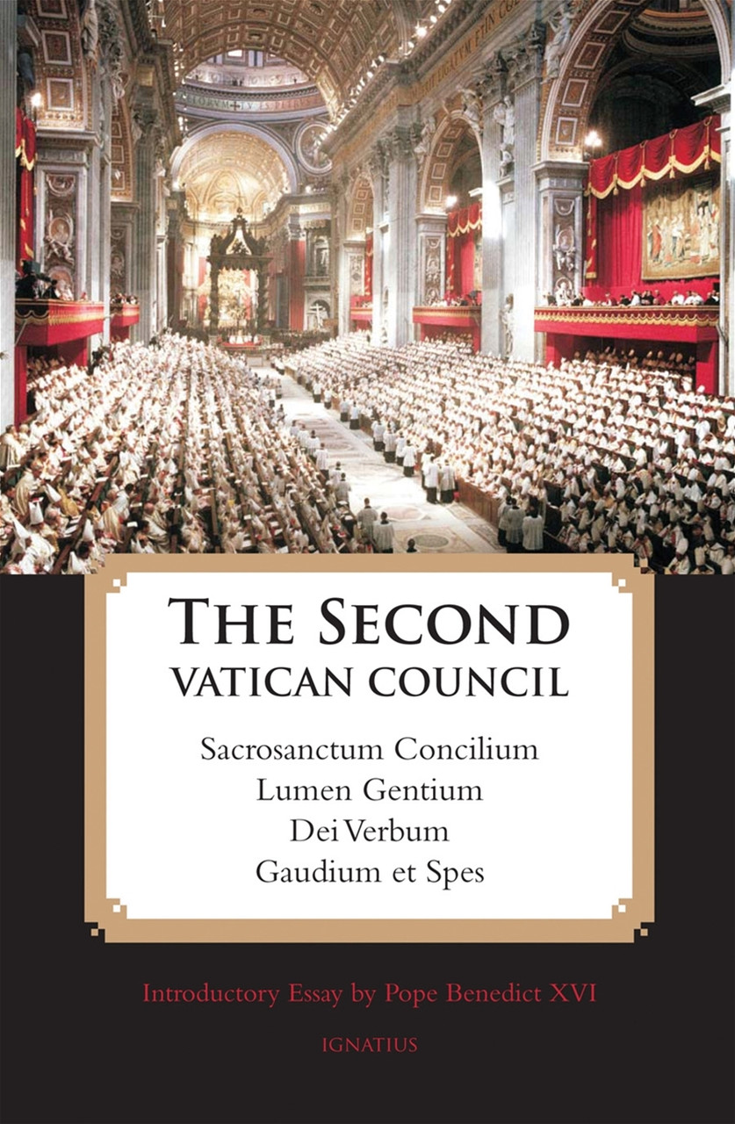
Gravissimum educationis Underdeveloped.
No comprehensive legal framework.
No methodological foundation.
On Catholic universities (n. 10) for theological faculties (n. 11).
Major conciliar texts:
Gaudium et spes,
Apostolicam actuositatem.

Slide 18

CIC
Catholic uni. (canons 807–814)
Ecclesiastical uni. (canons 815–821).
Ex corde Ecclesiae (1992) "Magna carta".
Documents on laity. Specialized expertise.
Documents competent dicasteries. Praedicate Evangelium
Post-synodal exh. On regions where peace is fragile—(Africa, Asia, Latin America, Oceania) Mention the role of universities.

Slide 19
"Promotion of peace as intrinsic to the mission of ecclesiastical institutions of higher education (nn. 32–33).
Complex human, social, natural, and environmental challenges (n. 22).
Ex. Cord. Eccl.
Congregation for Catholic Education’s document issued on the fiftieth anniversary of Populorum progressio. (2017)
Economic, financial, labor,
Political, environmental, demographic, migratory.
international terrorism,
mutual distrust and hatred, social injustices (poverty).

Slide 20


Series of papal and Holy See statements:
Engage security challenges.
Limited concrete guidelines are offered on the “how.”
z

Slide 21

Congregation for Catholic Education
Research method: Not use the term "transdisciplinarity." Networks of cooperation” (n. 26).
On the anniversary of Populorum progressio.
z

Slide 22

Law faculty:
"Should train jurists who advocate for the most vulnerable and employ the law as an instrument of social justice." Joseph Bellacosa - Andrew Anderson.
Economics:
Reconciling: Catholic social teaching (primacy of the poor and the the common good) .
Mainstrem economics, free-market and global capitalism.
"Contribute to the fuller developmentof the human person" (c.807).

Slide 23
Antiqua et Nova document.
Complexity - artificial intelligence affects the entire Catholic university.
Statements by the Pope and the Holy See on artificial intelligence
Opportunities - Challenges.

Slide 24
Methodological challenge
Religious studies/theology
Lacking a unified methodology.
The Catholic University & AI: Areas of Impact, Dialogue, and Methodology?
z

Slide 25
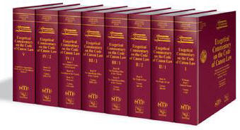
- Catholic theological teaching approved by ecclesiastical authority, not “theology” in general.
Davide Cito
- Theology illuminated by faith.
Not religious studies.
§2. In individual Catholic universities, there are to be classes which especially treat those theological questions which are connected to the disciplines of their faculties. (811. C.)

Slide 26

Legally obliged to provide a Catholic theological interpretation. (811. c.)
Not only how religion in general affects AI.
What Church: " about AI and specific challenges."
(An internal, normative reflection.)
- Alvaro del Portillo; Carlos José Errazuriz:
"The faithful’s right to know Catholic teaching is not abstract, but arises in concrete life situations. (can. 229).

Slide 27
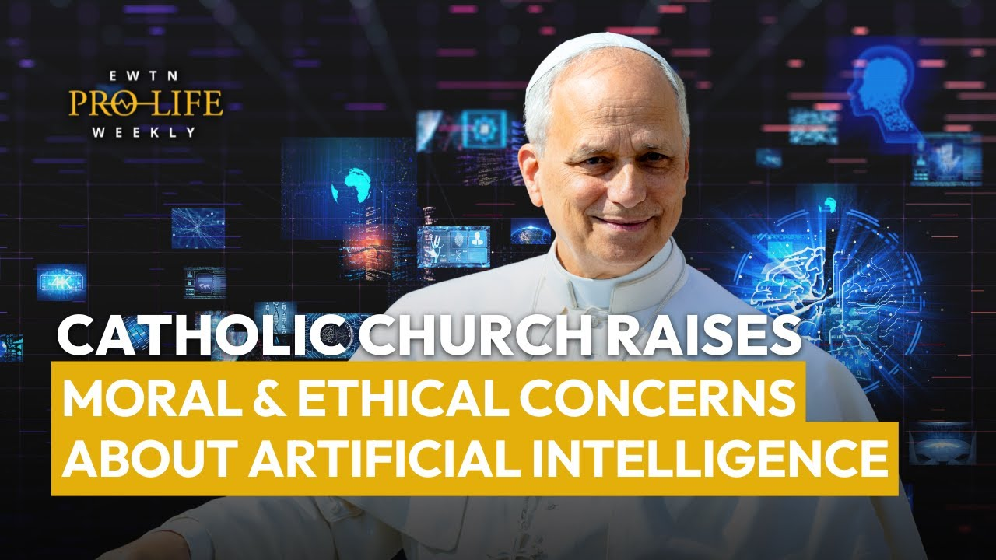
A strict interpretation of the law (c. 811)
Sufficient to present the Church's social teaching on AI, in a separate course.
More effective
Complex interpretation of specific challenges:

Slide 28

Pope Francis – Message for the 57th World Day of Peace (Jan 1, 2024)
Artificial Intelligence and Peace
Dicasteries for Doctrine of the Faith & Culture – Antiqua et Nova (Jan 2025)
"Note on the Relationship Between Artificial Intelligence and Human Intelligence"
Pontifical Academy for Life
Rome Call for AI Ethics (2020)
z

Slide 29
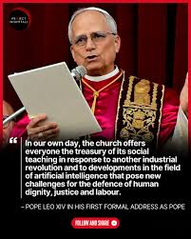
Leo XIV
z
Inference on Artificial Intelligence, Ethics, and Corporate Governance (2025)
(Catholic social teaching, theological anthropology, ethics of technology, governance, education/child development, philosophy of mind and epistemology.)
Message to the “Builders AI Forum (2025)
(Theology of creation, virtue ethics, design ethics, philosophy of technology, sociology of innovation, business ethics, pastoral theology)

Slide 30
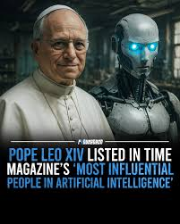
New industrial revolution” driven by AI.
Challenges:
Defence of human dignity, justice and labour.
Communication not information transfer; it creates human and digital environments.
Address to the College of Cardinals
Programmatic Vision of His Pontificate
Audience to Representatives of the Media (May 2025)

Slide 31
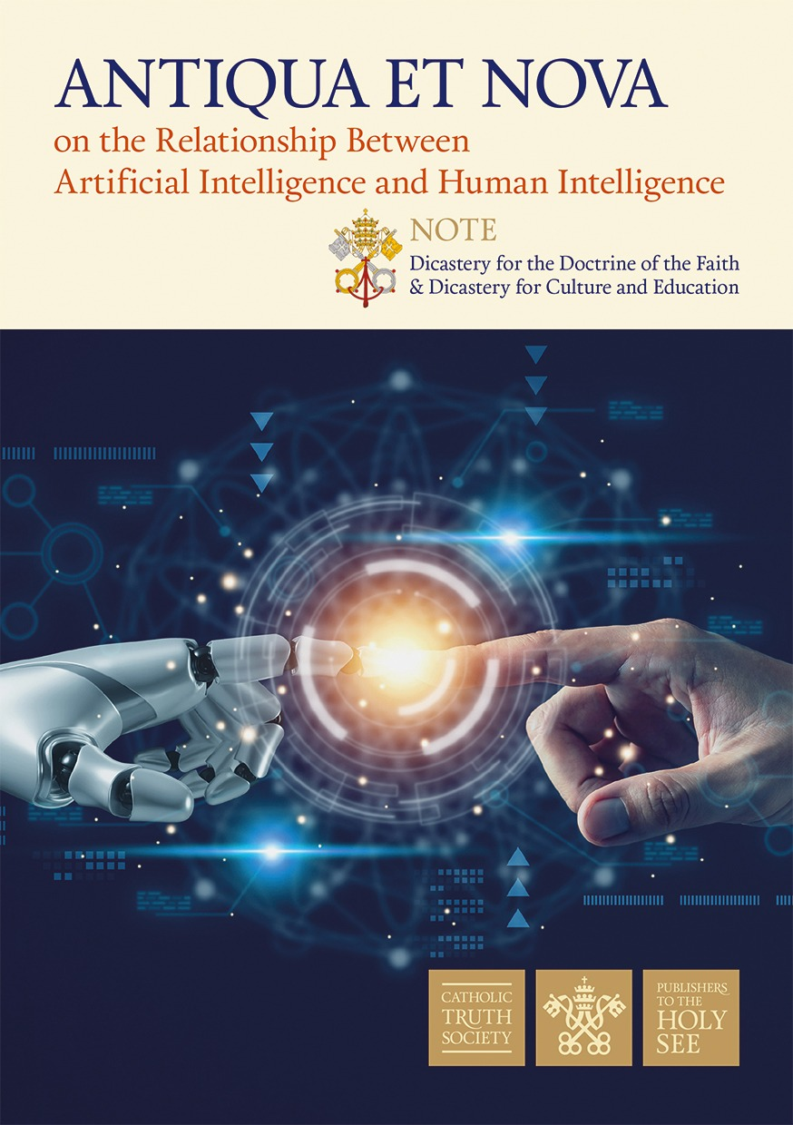
Complexity
z

Slide 32
AI Impact Area (Antiqua et Nova) | Interacting Secular Disciplines | Theological & Ethical Focus (The Interface) | Required Scientific Methodologies
1. Warfare & Peace (Autonomous Weapons/LAWS, Dehumanization of conflict) | International Relations, Military Science, International Law | From Just War to "Just Peace": Re-evaluating war in the age of machines. Ensuring human moral agency in lethal decisions. | Strategic Risk Assessment: Modeling escalation scenarios with autonomous systems. Legal Analysis: Drafting regulatory frameworks for LAWS.
2. Healthcare & Bioethics (Diagnosis, Doctor-Patient relationship, Inequality) | Medicine, Data Science, Public Health, Sociology | The Good Samaritan Principle: Preventing "medicine for the rich" and preserving the human encounter in healing. | Clinical Ethics Consultation: Case studies on AI diagnostic errors. Algorithmic Auditing: Detecting bias in medical triage algorithms.
3. Economy & Labor (Automation, Deskilling, Surveillance) | Economics, Management, Labor Law, Psychology | Dignity of Work: Work is for the person, not the person for work. Combating the "Technocratic Paradigm." | Economic Forecasting: Analyzing labor displacement vs. creation. Psychological Impact Studies: Measuring the effects of algorithmic management on worker stress.
4. Education & Formation (Critical thinking vs. Generative answers) | Pedagogy, Cognitive Science, Psychology | Integral Human Development: Educating the "head, heart, and hands," not just processing information. | Longitudinal Educational Studies: Tracking the long-term impact of AI tools on cognitive development. Action Research: Testing AI literacy curriculums.
5. Human Relationships (Anthropomorphism, Empathy, Solitude) | Anthropology, Psychology, Communication Studies | The Theology of the Body: Distinction between simulation (AI) and authentic encounter (Human). Avoiding idolatry of connection. | Qualitative Research: Interviews and ethnography on human-chatbot attachment. Phenomenological Analysis: Exploring the lived experience of "digital solitude."
6. Truth & Democracy (Deepfakes, Disinformation, Polarization) | Media Studies, Political Science, IT Forensics | Service of the Truth: Defending the "crisis of truth" in the public forum. Trust as a foundation of society. | Digital Forensics: Developing tools to detect deepfakes. Network Analysis: Mapping the spread of misinformation in polarized communities.
7. Ecology (Common Home) (Energy consumption of LLMs) | Environmental Science, Computer Engineering | Stewardship of Creation: Recognizing that "the Cloud" has a heavy physical/ecological cost. | Life-Cycle Assessment (LCA): Measuring the carbon footprint of training large AI models. Green Computing: Researching energy-efficient hardware.
8. Theology & Metaphysics (AGI, Transhumanism, Idolatry) | Philosophy of Mind, Systematic Theology | Imago Dei: Defining consciousness vs. computation. Resisting the temptation to "substitute God for an artifact." | Hermeneutics: Interpreting biblical texts (e.g., on idols) in the context of digital entities. Metaphysical Inquiry: Investigating the nature of "intelligence."

Slide 33
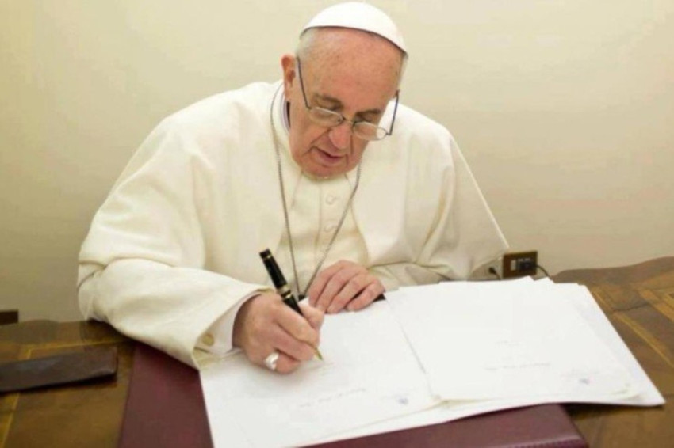
Transdisciplinarity as a Mandate But where does theology fit in?
z
Pope Francis’ Apostolic Constitution, Veritatis Gaudium

Slide 34
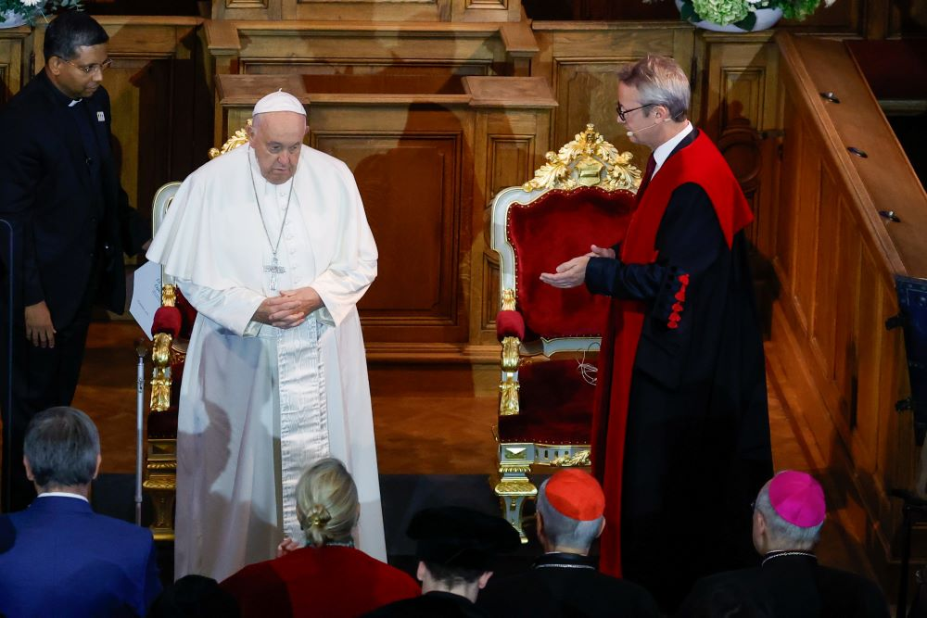
Ecclesiastical universities and the sacred sciences in the service of peace
Sapientia Christiana
The role of the natural and social sciences: Remained marginal.
Did not appear as equal partners.
The Code of Canon Law (cc. 815-821).
The broader legal framework:
Const. AP. Veritatis gaudium.
Replaced Sapientia christiana.

Slide 35
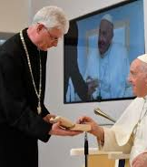
Veritatis gaudium
Greater emphasis on trans- and interdisciplinary dialogue.
Speech at the Catholic university in Budapest,
Dialogue-based, active theology.
ANTIQUA ET NOVA
"Global dialogue"
z

Slide 36
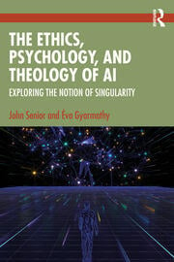
Jesús Manuel García Gutiérrez:
"Veritatis Gaudium" positions theology to start from lived experiences rather than from doctrine."
AI, theology must offer a performative interpretation of the reality
New technologies.
Rather than just observing them from the outside.
Theology as a Laboratory

Slide 37
Bruno Esposito:
Introduction/Novelty of Veritatis
Gaudium.
New methodology - mandatory
Inductive research method:
Not deductive
As for AI :
The involvement of other sciences.
Performative interpretation of the reality (New technologies)
Rather than just observing them from the outside.
Dialogue: within the Catholic university or outside.

Slide 38
At the same time – the constitution, similar to the old law:
Maintains the guarantes.
"Revelation is the framework for research."
Faculties of philosophy:
Scholasticism and St.Thomas Aquinas.

Slide 39
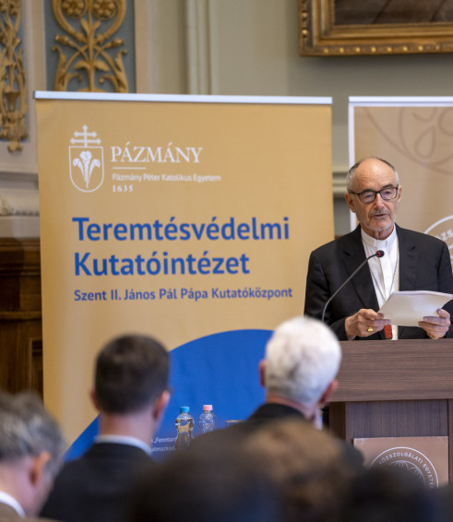
Joint research
z
Theology as a Laboratory
Joint Phd Program.
Workshops, conferences.
Joint publication – AI questions.
Specialized Research Courses Institutes for AI

Slide 40
Conclusion
Historical Foundation:
Catholic academia has consistently contributed to the understanding of new technology
A theology-centric perspective.
Evolution
Shift towards interdisciplinary dialogue.
Current Paradox:
Guiding documents provide a framework for a cooperative approach to peace and security studies.
However, the results are still limited compared to the potential.
Key Challenges:
Methodological shortcomings, a lack of specialized human capital,
need for more robust institutional structures to support interdisciplinary work.
The Solution:
Strategic Collaboration.
Strengthening partnerships within the Catholic university/ the Faculty of Theology.
Externally: Building strategic alliances with other universities to share expertise and resources.
A Model for Success:

